Slide 1

<Sentimental Analysis of Twitter Data>
School of Computer Science and Engineering
Department of Computer Science and Engineering
Submitted By: <Mahi Agrawal>
<23fe10cse00254>
Supervised By: <Dr. Mayank Namdev>

Slide 2
Outline
Introduction
Literature Review
Problem Statement
Objectives
Proposed Methodology
Results
Outcome
References

Slide 3
Introduction
Social media platforms have become a major source of real-time public opinions and reactions.
Among them, Twitter (X) is widely used for expressing thoughts in domains such as:
Politics
Healthcare
Finance
Social issues
Sentiment Analysis is an NLP technique used to determine the emotional polarity of text as:
Positive
Neutral
Negative
Importance
Helps in decision-making by understanding public mood and opinion trends from large-scale Twitter data.

Slide 4
.
Motivation
Twitter generates massive volumes of data daily, making manual sentiment tracking impossible.
Sentiment analysis can provide automated monitoring of:
customer feedback
brand reputation
political sentiment
financial trends
Challenges in Twitter Sentiment Analysis
Tweets are short and informal.
Tweets contain:
slang, abbreviations
emojis and hashtags
sarcasm and irony
These characteristics make sentiment interpretation difficult for traditional models.
Need
A framework is required that provides:
high accuracy sentiment prediction
contextual understanding
explainability of model decisions

Slide 5
Literature Review
Early Approaches
Initial sentiment analysis studies used:
Lexicon-based methods
Traditional Machine Learning models
Common algorithms:
Naïve Bayes
Logistic Regression
Support Vector Machine (SVM)
Key Limitation
These methods are computationally efficient but fail to capture:
contextual meaning
semantic relationships
hidden sentiment in noisy tweets
Reference Insight:
Qi and Shabrina highlighted that lexicon + ML fails for noisy short tweets.

Slide 6
.
Deep Learning Expansion
With the availability of larger Twitter datasets, deep learning models became popular.
Models like LSTM were used to capture sequential word dependencies.
Neelakandan et al. proposed DLMNN with extensive preprocessing to improve accuracy.
Key Limitation
Deep learning models improve performance but still struggle with:
long-range dependencies
ambiguous expressions
computational cost

Slide 7
.
Hybrid and Transformer-Based Approaches
Hybrid models combine feature extraction + learning algorithms:
TF-IDF + SVM
Word2Vec + LSTM
These improve accuracy compared to baseline ML models.
Transformers
Transformer models like BERT provide strong contextual understanding.
BERTweet, pretrained on large-scale Twitter data, performs better than Word2Vec-based models.
Research Gap Identified
Most existing models focus mainly on accuracy.
Transformer models behave like black-box systems, lacking interpretability.
Need
A framework combining:
high performance sentiment classification (BERTweet)
hybrid model comparisons
explainable AI (SHAP) for transparency

Slide 8
Problem Statement
Twitter sentiment classification is difficult because tweets are short, noisy, and context-dependent, containing slang, emojis, and sarcasm. Existing models either lack contextual understanding or lack interpretability, creating a need for an accurate and explainable sentiment classification framework.

Slide 9
Objectives
To perform three-class sentiment classification on Twitter data (Positive, Neutral, Negative).
To evaluate traditional machine learning models (Linear Regression, Naïve Bayes, SVM) using TF-IDF features.
To implement and compare hybrid sentiment models:
TF-IDF + SVM
Word2Vec + LSTM
To fine-tune BERTweet, a transformer model pretrained on Twitter corpus, for improved sentiment classification.
To integrate Explainable AI (XAI) using SHAP to provide token-level interpretability.
To compare all models using standard evaluation metrics: Accuracy, Precision, Recall.

Slide 10
Proposed Methodology (4 slides)
Dataset source: Kaggle Twitter Sentiment Dataset
Tweets are labeled into 3 sentiment classes:
Positive
Neutral
Negative
Dataset contains noisy Twitter language such as:
emojis
hashtags
abbreviations
slang words
domain mentions

Slide 11
Data Cleaning and Preprocessing
To reduce noise and improve model learning, preprocessing steps include:
Removal of:
URLs
user mentions (@user)
hashtag symbols (#)
numeric values
punctuation
special characters
extra whitespaces
Convert all text into lowercase
Tokenization of tweets
Stopword removal
Lemmatization / Normalization
Emoji handling and mapping
Output
Clean and normalized tweets suitable for feature extraction and modeling.

Slide 12
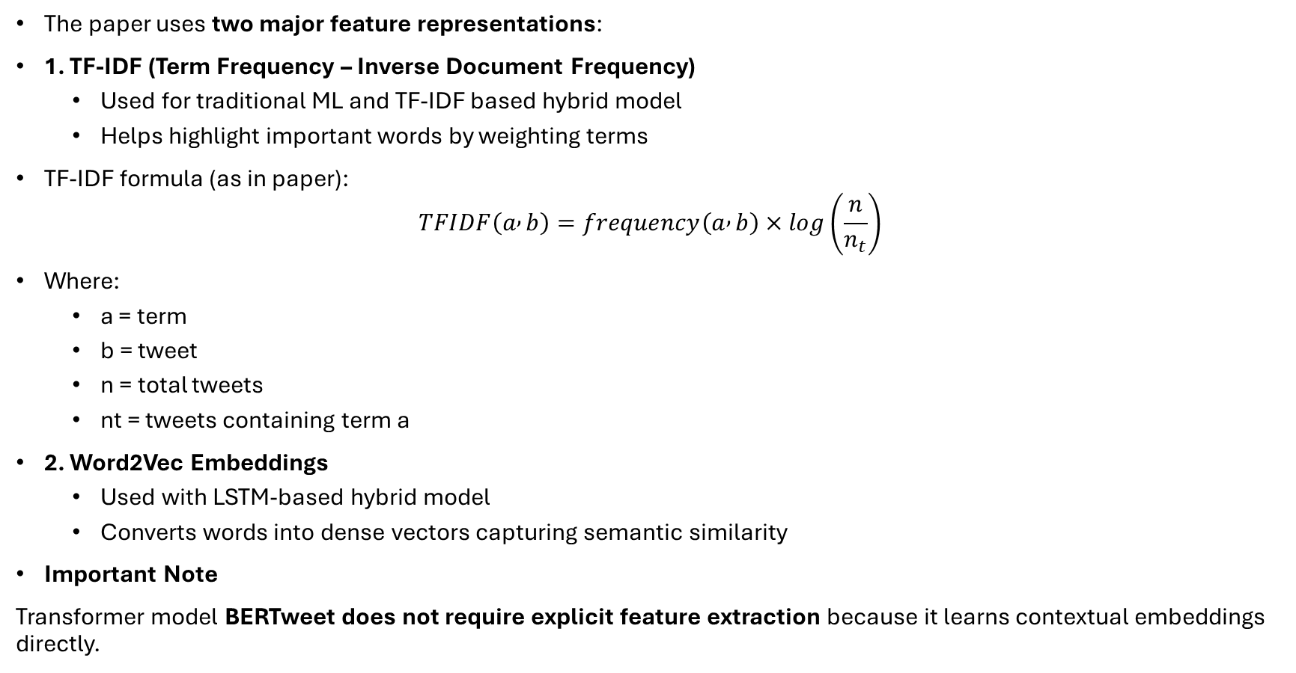
Feature Extraction Techniques
The paper uses two major feature representations:
1. TF-IDF (Term Frequency – Inverse Document Frequency)
Used for traditional ML and TF-IDF based hybrid model
Helps highlight important words by weighting terms
TF-IDF formula (as in paper):
$$TFIDF\left(a , b\right)=frequency\left(a , b\right)×log\left(\frac{n}{n_{t}}\right)$$
Where:
a = term
b = tweet
n = total tweets
nt = tweets containing term a
2. Word2Vec Embeddings
Used with LSTM-based hybrid model
Converts words into dense vectors capturing semantic similarity
Important Note
Transformer model BERTweet does not require explicit feature extraction because it learns contextual embeddings directly.

Slide 13
MODEL TRAINING & APPROACHES
Traditional Machine Learning Models (Baseline)
Using TF-IDF features, three models were trained:
Linear Regression (baseline classifier)
Multinomial Naïve Bayes
Support Vector Machine (SVM)
Hybrid Models
Hybrid models used to improve performance:
Hybrid Model 1: TF-IDF + SVM
Combines weighted lexical features with margin-based classification.
Achieves better class separation.
Hybrid Model 2: Word2Vec + LSTM
Word2Vec provides semantic dense vectors.
LSTM captures sequential context of words.
Deep Learning Model
Separate LSTM model implemented for sequence learning.
Transformer Model
Fine-tuned BERTweet pretrained on large-scale Twitter corpus.

Slide 14
Result
Model Performance Comparsion
Model | Accuracy | Precision | Recall
Linear Regression | 84.2 | 83.6 | 82.9
Naïve Bayes | 82.5 | 81.9 | 81.2
SVM | 86.1 | 85.4 | 84.8
TF-IDF + SVM | 88.6 | 87.9 | 87.2
Word2Vec + LSTM | 89.3 | 88.7 | 88.1
LSTM | 87.4 | 86.8 | 86.1
BERTweet | 91.57 | 90.4 | 90.1

Slide 15
Outcome
Developed a complete sentiment classification framework using:
Traditional ML
Hybrid models
Transformer-based BERTweet model
Achieved maximum accuracy of 91.57% using BERTweet.
Successfully implemented explainability using SHAP to interpret predictions.
Demonstrated that transformer-based models outperform traditional and hybrid methods.
Paper is drafted and submitted in the conference

Slide 16
References
Qi, Y. and Shabrina, Z., Sentiment Analysis using Twitter Data, 2023.
Bello, A. et al., BERT Framework for Sentiment Analysis of Tweets, 2023.
Vaswani et al., Attention is All You Need, NeurIPS 2017.
Lundberg & Lee, SHAP Explainability, NeurIPS 2017.
Nguyen et al., BERTweet EMNLP 2020.

Slide 17
Thank You

